Slide 1
CHAPTER 1
APPLICATIONS OF INTEGRATION

Slide 2
CONTENTS
1.1. More about Areas
1.2. Volumes
1.3. Arc Length
1.4. Average Value of a Function
1.5. Applications to Physics & Engineering
1.6. Applications to Economics & Biology
1.7. Areas & Lengths in Polar Coordinates

Slide 3
1.2. VOLUMES
1.2.1 Definition of Volumes
1.2.2. Solids of Revolution
1.2.3. Volumes of Solids that are not Solids of Revolution
1.2.4. Cylindrical Shells

Slide 4
1.2.1. Definition of Volumes
Recall that the volume of a right cylinder with base A and height h is
V = Ah
If the base is a circle with radius r, the cylinder is called a circular cylinder with volume
V = π r²h

Slide 5
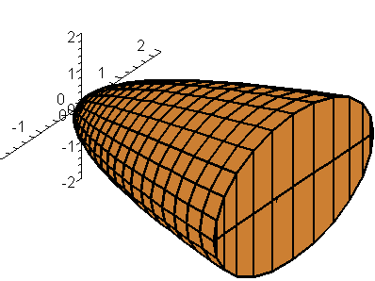
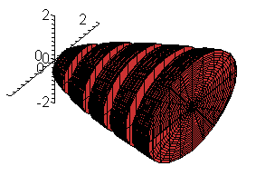
For a solid S that isn't a cylinder, we slice S into pieces and approximate each piece by a cylinder
Consider a section of S by a plane perpendicular to the x-axis at the point x. Let A(x) be the area of this section. We assume that A(x) is a continuous function

Slide 6
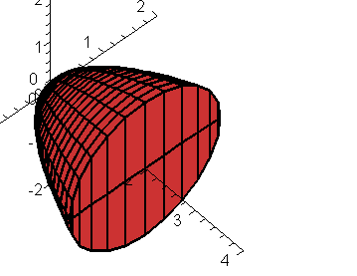
Consider a cross-section of S by a plane perpendicular to the x-axis at the point x. Let A(x) be the area of this section. We assume that A(x) is a continuous function
A(x)
x
We divide S into n slices of equal width Δx by the planes perpendicular to the x-axis at the point x₀, x₁,…, x_{i},…, x_{n}

Slide 7
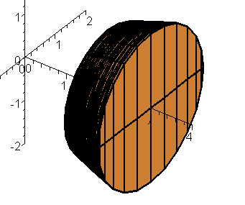
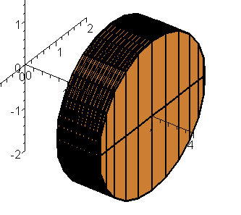
We approximate the i^{th} slice by a cylinder of basis A(x_{i}*) and height Δx, where x_{i}* is an arbitrary sample point in [x_{i-1,} x_{i}]. Therefore the volume V of S will be approximated by the Riemann sum
By passing to the limit we have

Slide 8
Definition of Volume. Let S be a solid that lies between x = a and x = b. If the area A(x) of the cross-section of S in a plane P_{x} perpendicular to the x-axis at x is a continuous function, then the volume V of S is
Note. A(x) is the area of the moving cross-section of S in a plane perpendicular to the x-axis at x

Slide 9
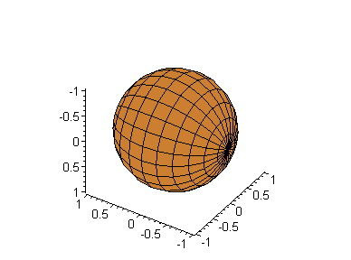
Example. Show that the volume of a sphere of radius r is
Solution. We suppose that the center of the sphere is at the origin, so the cross-section in the plan P_{x} is a circle of radius
Hence the cross-sectional area is
P_{x}

Slide 10
We have, by definition of Volume, with a = -r and b = r.
When r=1, the volume of the sphere is
V = 4.188790204

Slide 11
Note. We can approximate the volume of the sphere by dividing it into 5, 10, 15 slices and then approximate each slice by a cylinder with cross-sectional area A(x_{i}*) where the sample point x_{i}* may be selecting as the midpoint of [x_{i-1}, x_{i}]

Slide 12
1.2.2. Solids of Revolution
The sphere is a solid of revolution. It is obtained by rotating half of a circle about a diameter (the axis of rotation). The cross-section by a plane P_{x} is a circle of radius
Hence the cross-sectional area is

Slide 13
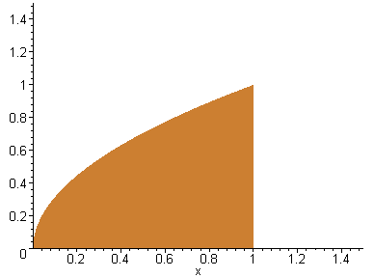
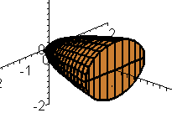
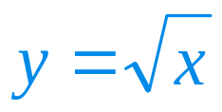
Example. Find the volume of the solid obtained by rotating about the x-axis the region under the curve from 0 to 1
Solution. When we rotate the region on the right about the x-axis, we obtain a circular paraboloid shown on the left.
The area of a cross-section through x is

Slide 14
Hence the volume is

Slide 15
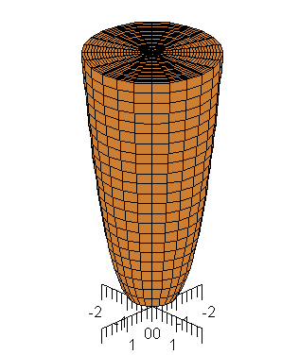
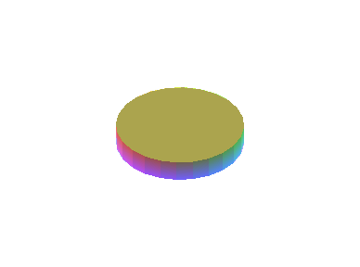
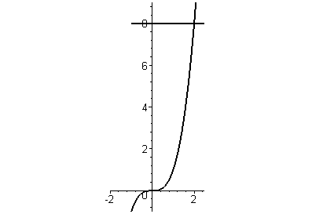
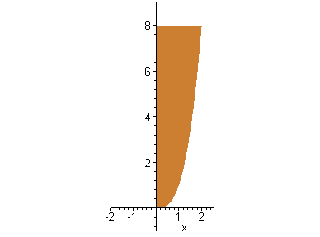
Example. Find the volume of the solid obtained by rotating about the y-axis the region bounded by y=x³, y=8 and x=0
Solution. When we rotate the region on the right about the y-axis, we obtain the solid shown on the left.
The area of a cross-section through y is

Slide 16
Hence the volume of the approximating cylinder is
The volume of the solid is

Slide 17
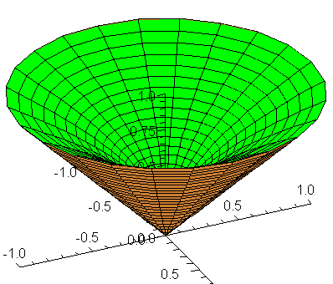
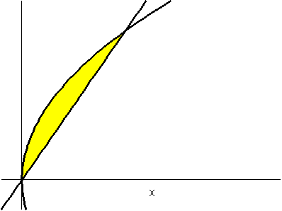
Example. Find the volume of the solid obtained by rotating about the x-axis the region bounded by y = x and y = x²
Solution. When we rotate the region on the right about the x-axis, we obtain the solid shown on the left.
x
y

Slide 18
The cross-section through x is an annular ring with area
Therefore
x
y
y

Slide 19
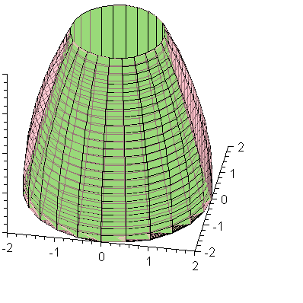
Example. Find the volume of the solid obtained by rotating about the line y = 2 the region bounded by y = x and y = x²
Solution. When we rotate the region on the right about the line y = 2, we obtain the solid shown on the left.
The cross section is an annular ring with area
x
y

Slide 20
Therefore the volume of the solid is

Slide 21
In general we calculate the volume of a solid of revolution by using one of the formulae
Where the area of the cross-section A(x) or A(y) is:
A = πr² if the cross-section is a disk of radius r (r depends on x or y)
A = πr₁² – πr₂² if the cross-section is an annular ring of outer radius r₁ and inner radius r₂ (r₁ and r₂ depend on x or y)

Slide 22
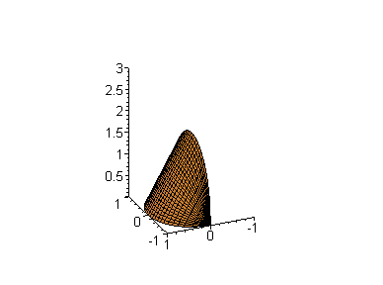
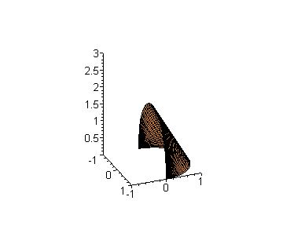
1.2.3. Volumes of Solids that are not Solids of Revolution
Example. Find the volume of a solid of circular base of radius 1 such that parallel cross-section in a plane P_{x} is an equilateral triangle.
Solution. We can assume that the equation of the base circle is x² + y² = 1

Slide 23
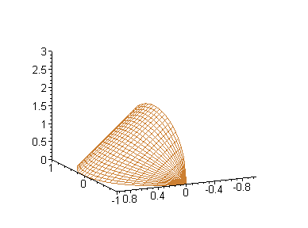
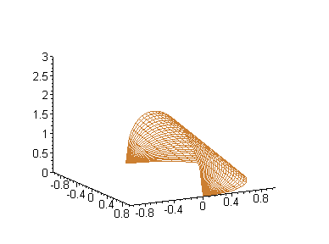
Solution. The base and the height of the sectional triangle are
The cross-sectional area and the volume of the solid are
B
C
C
x
B
A
A
H
B
A

Slide 24
Example. Find the volume of a pyramid whose base is a square of side L and whose height is h
Solution. The cross-section by the plane P_{x} is a square of side s such that
Therefore the cross-sectional area and the volume of the solid are
L
s
h
x

Slide 25
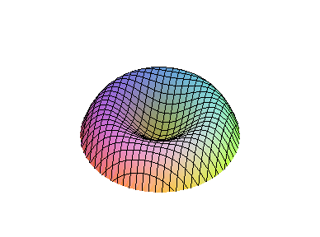
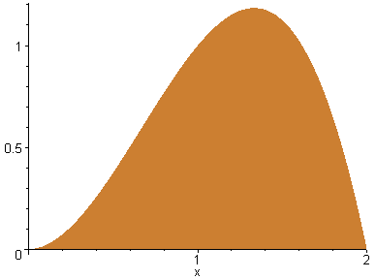
1.2.4 Cylindrical Shells
Sometimes it is difficult to handle the volume problem by slicing methods.
For instance let find the volume of the solid of revolution on the right obtained by rotating the region on the left about the y-axis
y=2x² – x³
x_{L}
x_{R}

Slide 26
To apply slicing methods as in 1.2.2, we have to find the inner and outer radius of the cross-section. To do that we have to solve the equation
2x² – x³ = y
for x in terms of y, which is difficult
However we also have the method of cylindrical shells.
Instead of slicing the solids into cylinders or annular rings of small height as in 1.2.2, we approximate the solids using very thin cylindrical shells

Slide 27

Example. Find the volume of the solid obtained by rotating about the y-axis, the region under the curve y = 2x² – x³
Solution. We divide the interval [0, 2] into n subintervals of equal width Δx.
When being rotated about the y-axis, a typical rectangle generates a cylindrical shell of radii x_{i-1} and x_{i} and height 2(x_{i}*)² - (x_{i}*)³ where x_{i}* is a sample point in [x_{i-1}, x_{i}]
y=2x² – x³
Δx

Slide 28
The volume of the cylindrical shell is
Hence

Slide 29
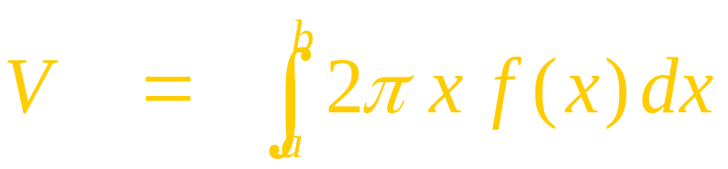
Letting n→∞ we will obtain the volume of the solid
In general if we rotate the region under the curve y =f(x) about the y – axis, then the volume is
y=f(x)
a
b

